Slide 1
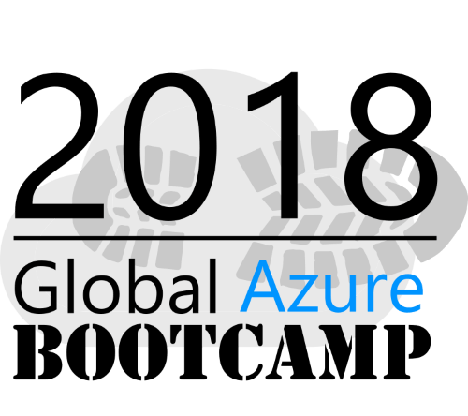
Welcome to
Azure Bootcamp Asp.Net Core & DevOps
Tallinn

Slide 2
Agenda
11:30 – 11:45 Welcome and Into
11:45 – 13:00 ASP.NET Core and Azure and DevOps Masterclass
13:00 – 14:00 Lunch
14:00 – 17:00 Self-Paced HOLs & Proctors supporting

Slide 3
Goal
Go through one type of application development in Azure in practice and get to know ASP.NET Core & Azure & do it automated manner

Slide 4
Step 0 Intro + Portail Azure

Slide 5
Goal
Getting to know Azure and the Portal

Slide 6
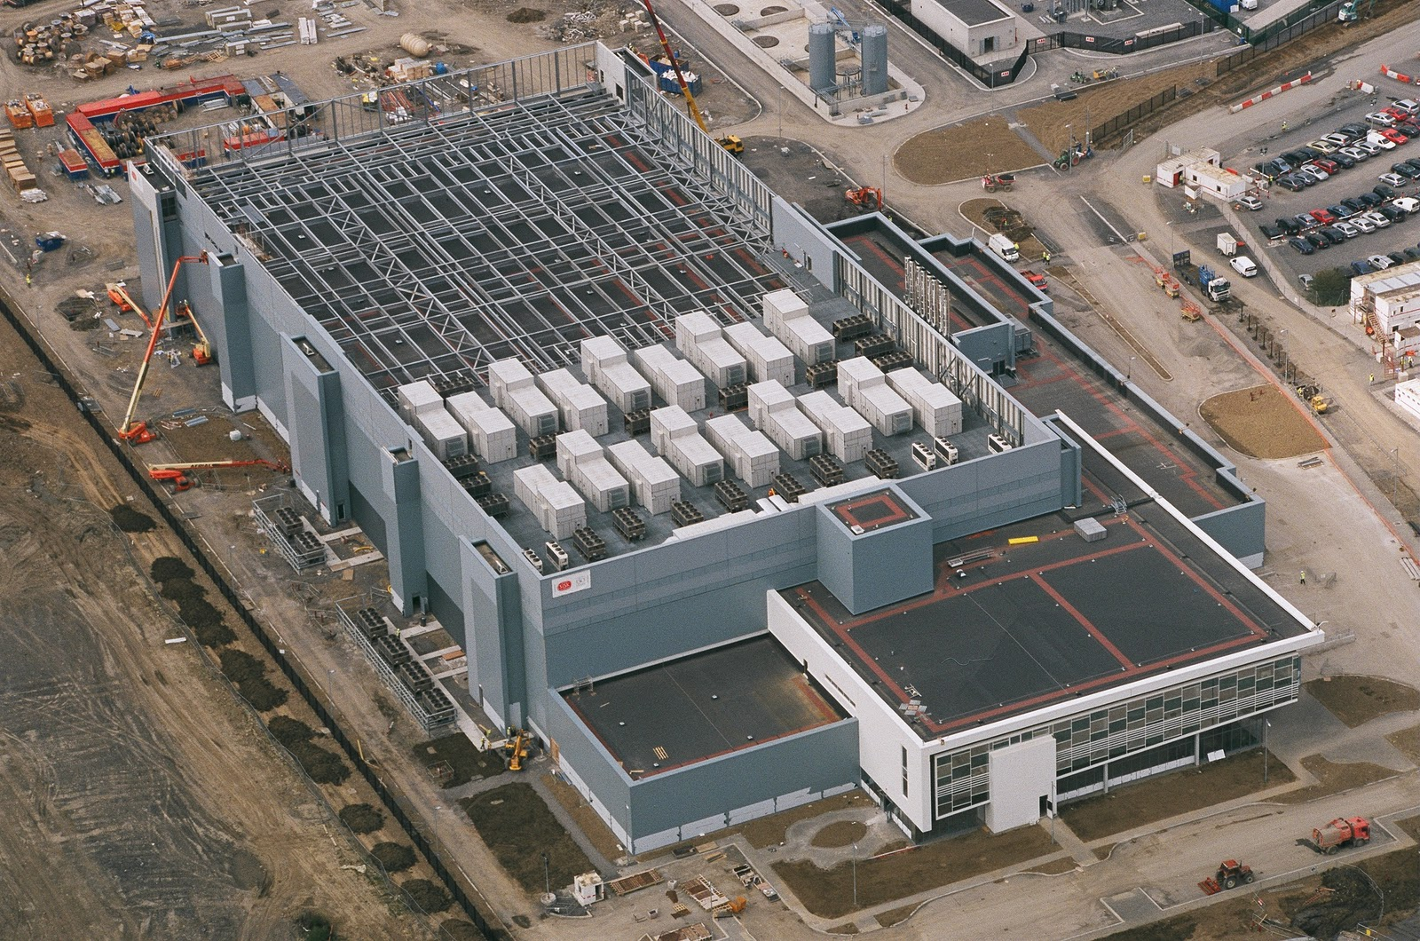
Notes:
This is what we think of when we hear the word “Datacenter”

Slide 7
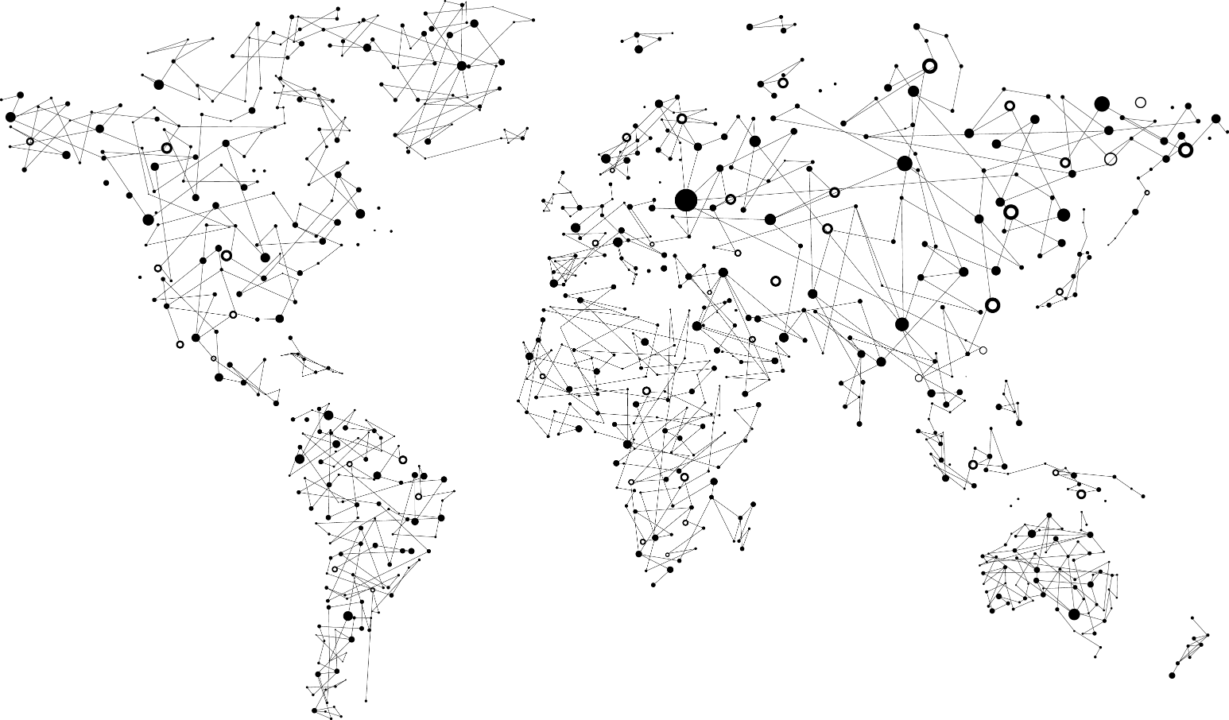
Achieve global scale, in local regions
Trust
38
Azure regions
RECENTLY LAUNCHED:
US Regions: West US 2 and West Central
Germany – Launched in Sep 2016
United Kingdom – Launched in Sep 2016
NEWLY ANNOUNCED:
France: France Central and France South
Korea: Korea Central and Korea South
DoD East and Central
Notes:
At the core of Azure is its global infrastructure that spans 38 regions worldwide. We have the largest footprint of any cloud provider.
https://azure.microsoft.com/en-us/regions/
https://azure.microsoft.com/en-us/regions/services/

Slide 8
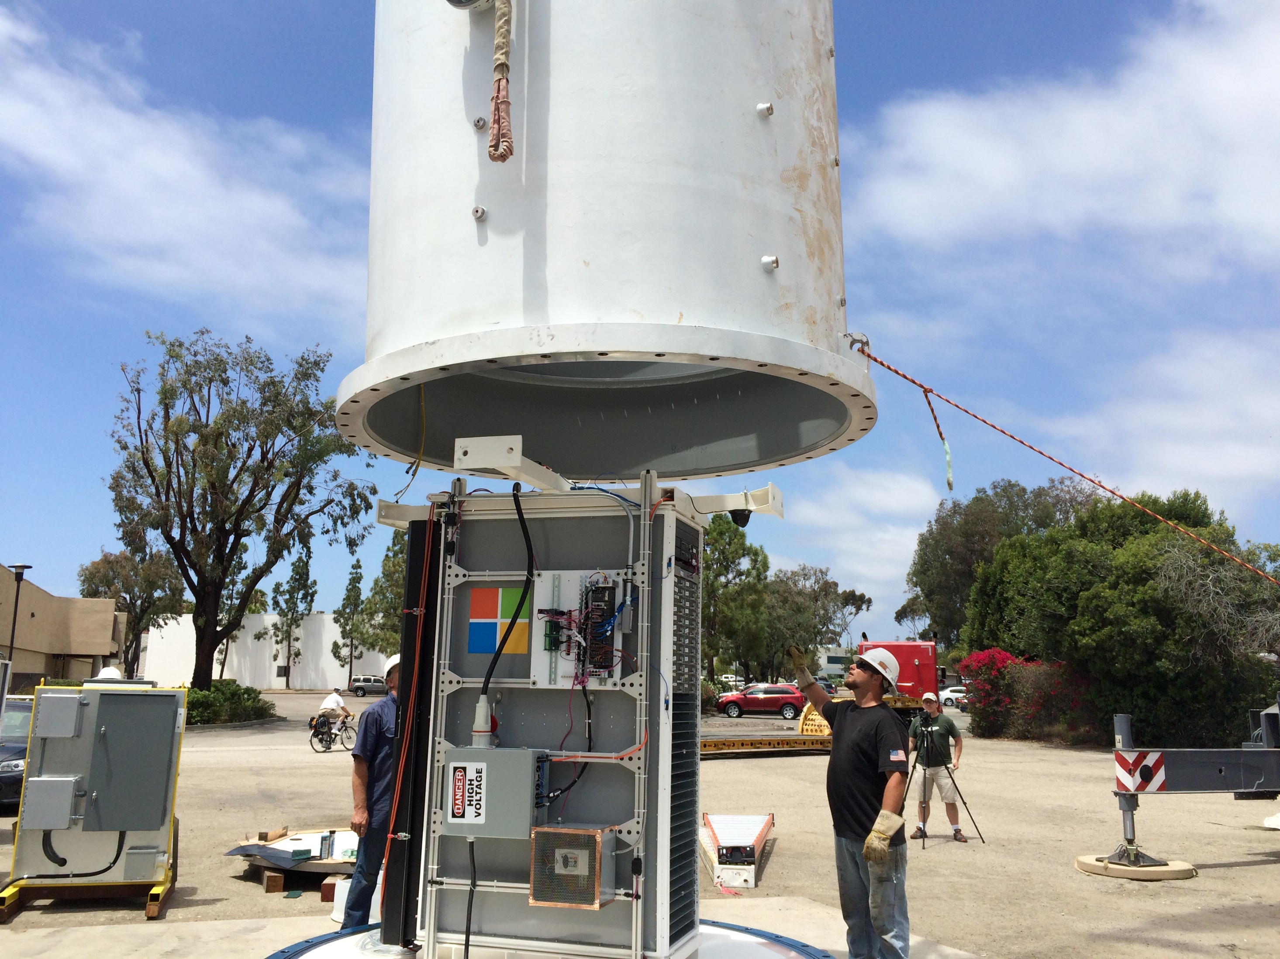
Notes:
My kids will probably hold a very different images of what a data center is. Microsoft Research is actively working on new approaches to bring resources online with more agility and proximity.

Slide 9
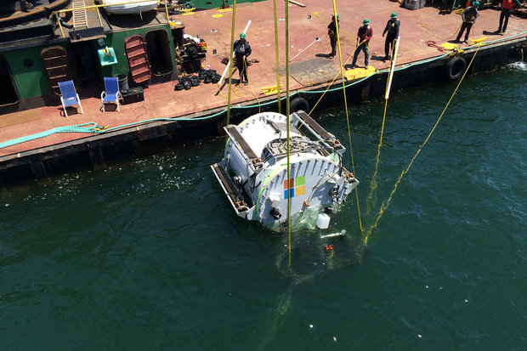
Notes:
Con’t

Slide 10

Notes:
Azure isn’t about Windows, its about enabling you to achieve more. Microsoft is undergoing a tremendous transformation and Linux/ Open Source Software is part of it. In a second we will dive in and I want you to remember that Microsoft is now the number contributor to OSS on GitHub and that some of the offered services are built and operated on Linux.
One of these services is the Azure SDN (Software Defined Network)
http://www.datacenterdynamics.com/content-tracks/servers-storage/microsoft-runs-azure-networking-on-linux/94837.fullarticle
Azure cloud uses Linux to handle data center networking - in a specialized software component developed by Microsoft to run conectivity within its cloud operating system, along lines set out by the Open Compute Project.

Slide 11
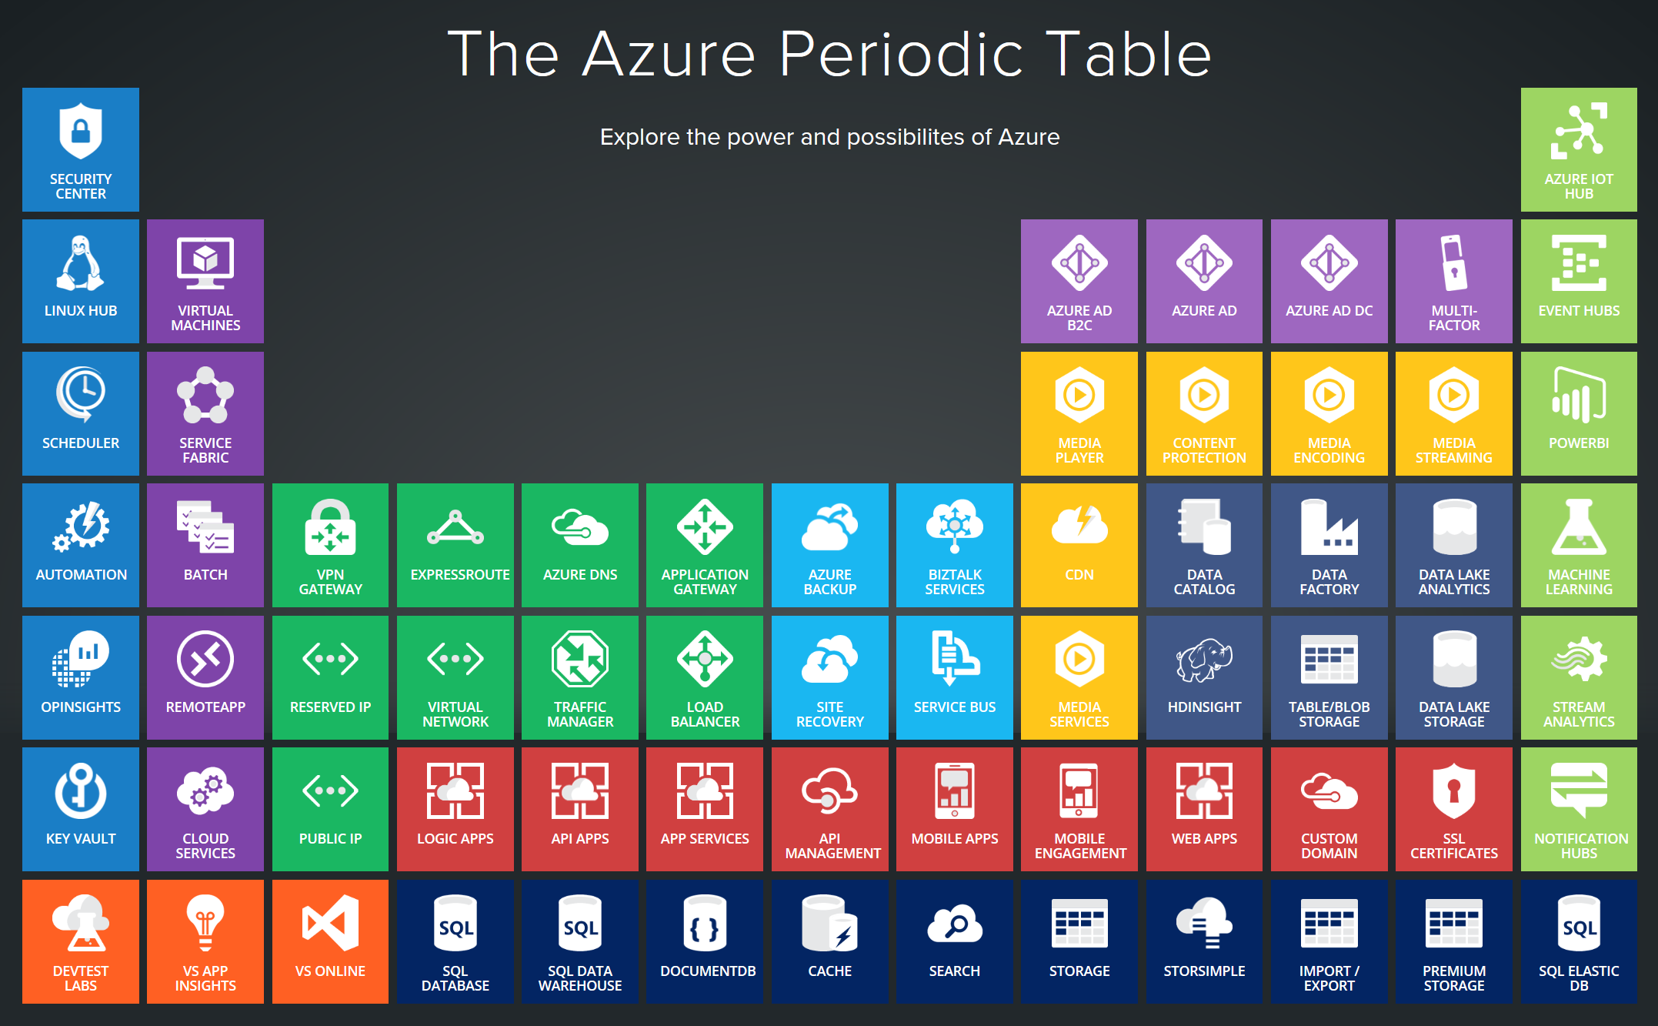
Notes:
Azure services support a multitude of scenarios from Infrastructure to platform services and extends your existing environments through various interconnectivity options. In today’s world, the level of sophistication required to innovate and compete requires us to be agile and adjust to a rapidly changing landscape. The cloud-only approach doesn’t work well for every scenario. Think about IoT and business critical workloads that drive delay sensitive manufacturing processes. Success comes from taking a hybrid approach and leveraging the cloud where it makes sense.

Slide 12
http://portal.azure.com
Notes:
Walk through the different sections, support tickets, azure market place, resource groups….

Slide 13
References:
Get started with Azure
Microsoft Azure Blog
Azure Updates
Cloud Platform roadmap
Azure Code Samples
Azure Quickstart Templates
AzureCAT Guidance
Cloud Design Patterns

